Slide 1
Steering Diffusion Language Models via Policy Learning
Ajay Jagannath Anant Mehta
Code: https://github.com/anantmehta33/DLM_with_Policy

Slide 2
Large Language Models
Is the autoregressive paradigm the only path to achieving the core capabilities of LLMs, such as scalability, in-context learning, and instruction-following?
Autoregressive Models
Masked Diffusion Language Models

Slide 3
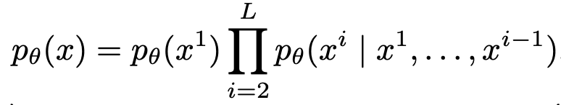
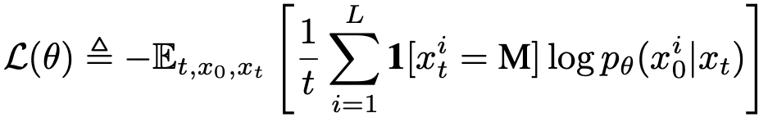
Towards Discrete Diffusion
Autoregressive Models
Masked Diffusion Language Models

Slide 4
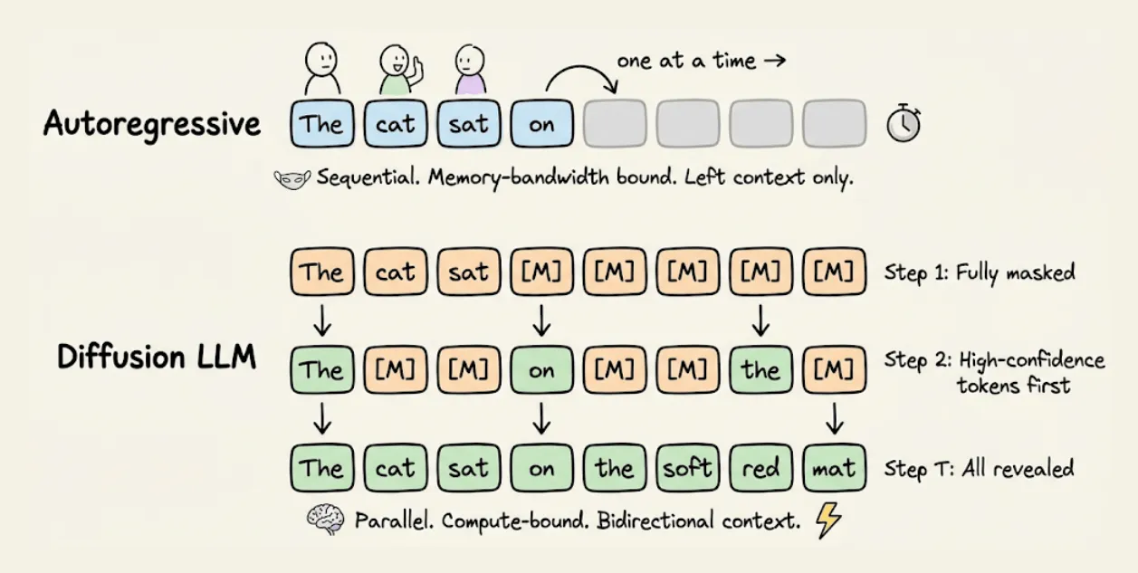
During Inference..

Slide 5
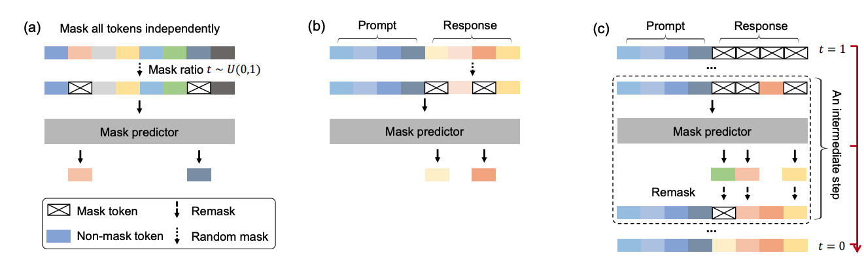
Masked Diffusion Language Model in this study
We use the popular LLaDA models (1.5B and 8B) for our study
Nie, Shen, et al. "Large language diffusion models." arXiv preprint arXiv:2502.09992 (2025).

Slide 6
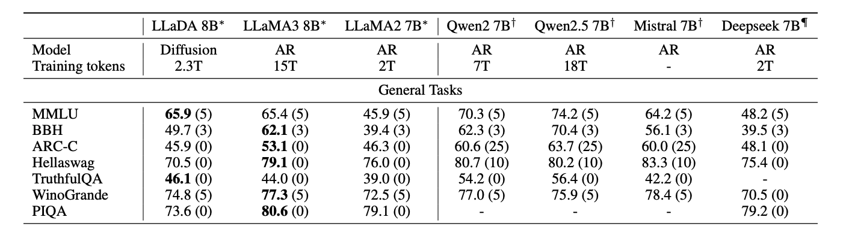
Why is it interesting?
Despite getting trained on much less tokens as compared to AR, LLaMA, LLaDA performances are comparable!!!!

Slide 7
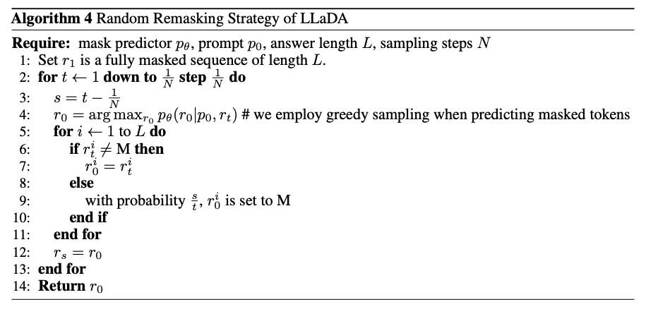
Remasking at Inference
Baseline is the confidence-based remasking!!!

Slide 8

Our Idea hits the core of inference
Heuristic-driven decoding is suboptimal
Methods like low-confidence remasking are hand-designed
Do not adapt to task-specific structure or constraints
Diffusion trajectory is crucial during inference!
Lack of adaptivity
Thus,
Remasking = sequential decision-making problem
This can be learned via RL instead of fixed rules!!

Slide 9
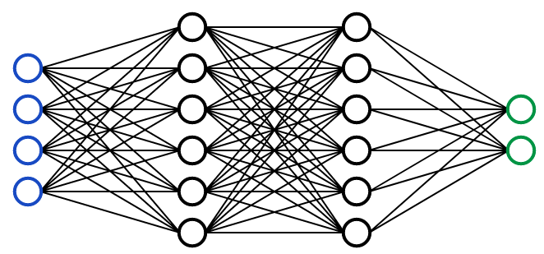



Policy-Based remasking v/s Confidence-Based
Policy Network
Embedding of current token (including masked state)
Entropy
The policy outputs per-token keep probabilities.
a_{t,i} ∈ {0, 1} indicates whether token “i” is kept (unmasked).
Actions are sampled independently with constraints enforced for fixed tokens.
Normalized probabilities over all the valid tokens
Normalized timestep t/T

Slide 10
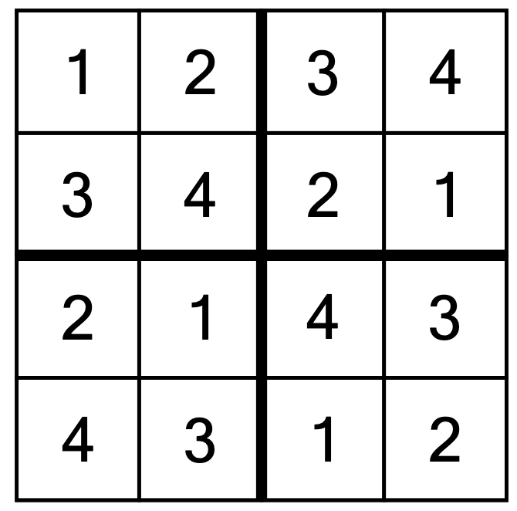
Dataset
4x4 Sudoku
Tokens Needed: 1,2,3,4.
Total States: 16
=> Zeroes depict the answers to be filled in.
Sample Input: 3102200002100320
Ground Truth: 3142243142131324
Training Set: 100 Samples
Test Set: 500 Samples
Remark: R^{K} are normalized probabilities over {1,2,3,4}!!
Datasets taken from “Siyan Zhao, Devaansh Gupta, Qinqing Zheng, and Aditya Grover. d1: Scaling reasoning in diffusion large language models via reinforcement learning. arXiv preprint arXiv:2504.12216, 2025.”

Slide 11

Reward Design
At each time step, reward calculated based on the following factors:
duplicates in each row
duplicates in each column
duplicates in each 2x2 subgrid
Dense improvement reward:
argmax(logits of valid tokens)

Slide 12
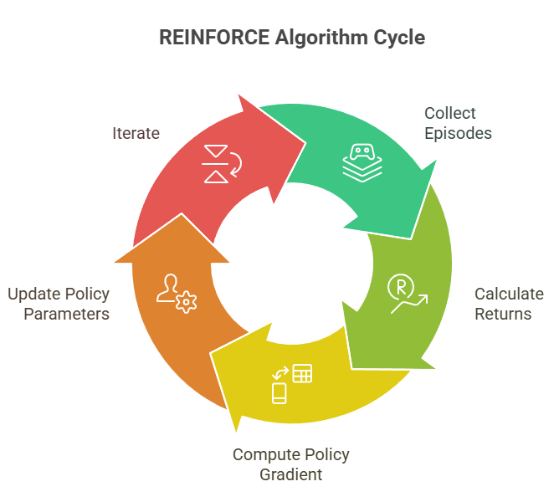
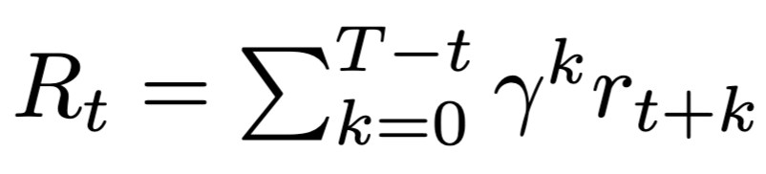
Reinforce Algorithm
Why: Simple, lightweight with no value network for policy evaluation
Return for a trajectory
Final Loss equation
Moving average of batch returns

Slide 13
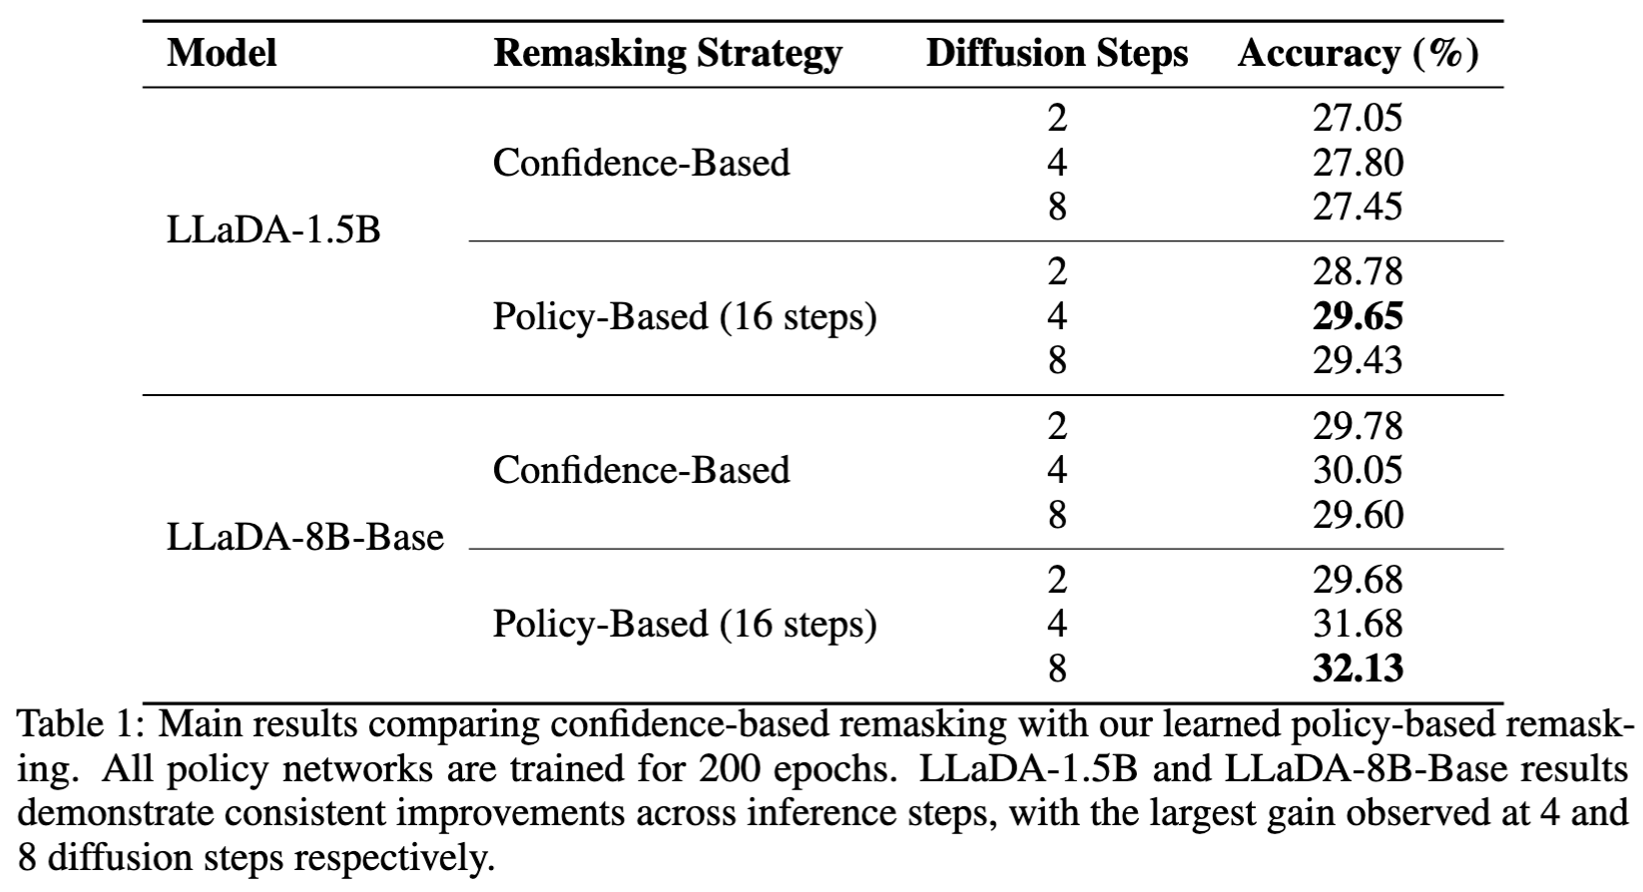

Main Results

Slide 14
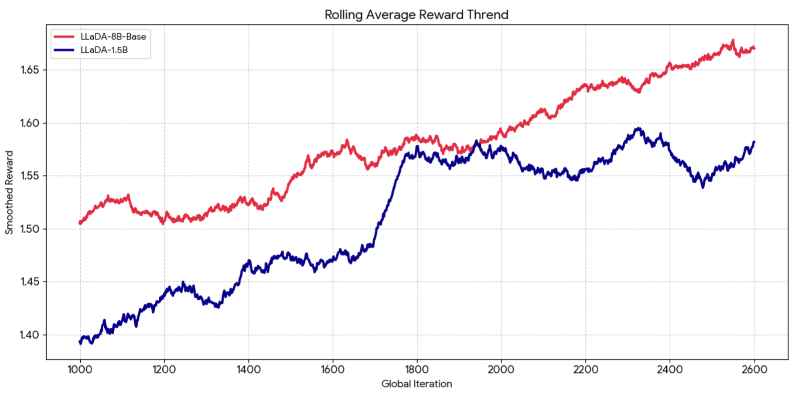
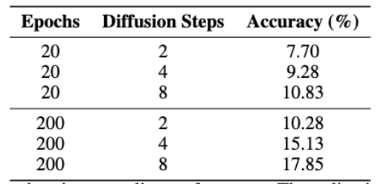

Reward Trends
As expected in both cases, reward increases with steps

Slide 15
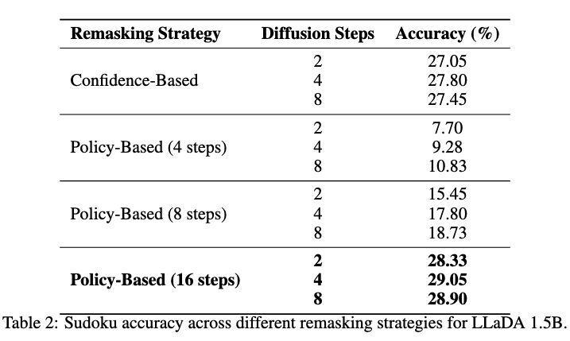
Ablations: Training with different steps
Policy Network trained with more diffusion steps is indeed better!!
Even with 2 steps during inference we are able to perform very well given policy is trained well

Slide 16
Takeaways and Discussion
Learned policies outperform fixed heuristics across settings in reverse diffusion at inference-time for MDLMs
We show consistent gains across steps and training regimes
Gains increase with more robust/well-trained policies (more epochs, steps)
Inference-time optimization is powerful
Gains come purely from better decoding decisions
No change to backbone (frozen LLaDA)

Slide 17
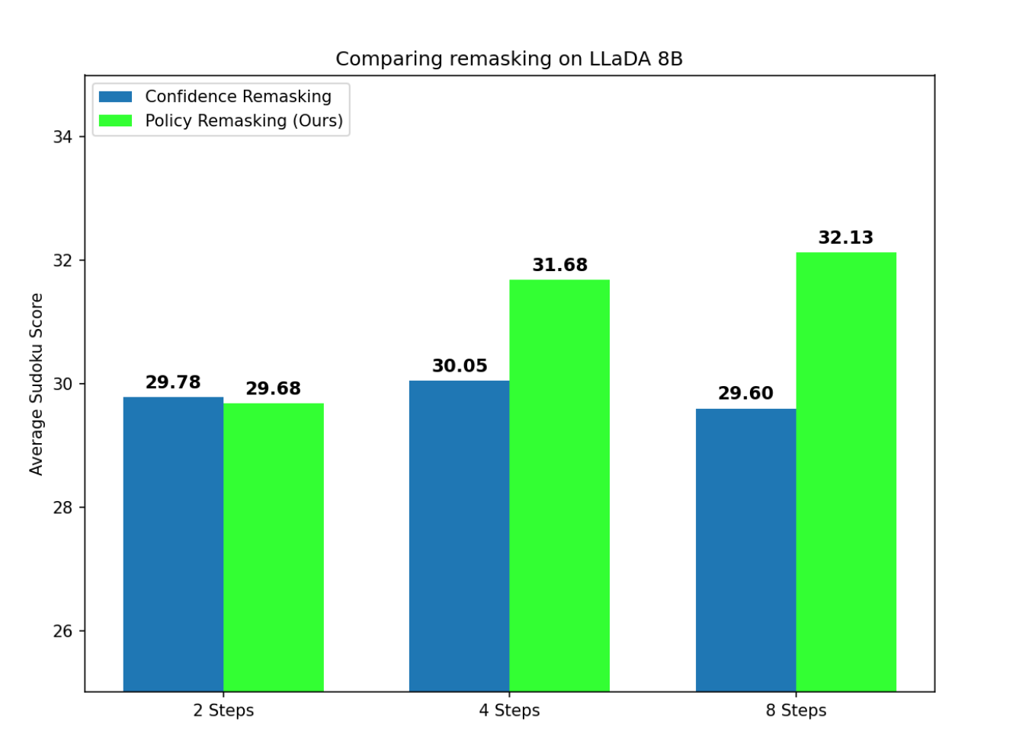
Takeaways and Discussion
We show that token refinement can be strategically guided
Not just iterative denoising, but decision-making

Slide 18
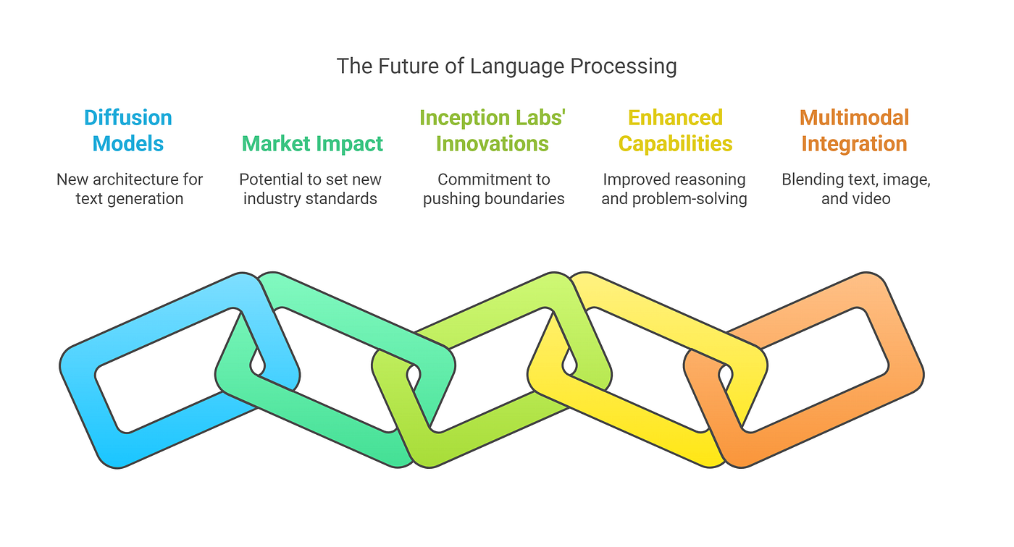
Future Directions
Exploring plug and play policies for different tasks at inference-time
Learn policies that reduce number of diffusion steps and yet give comparable results
Co-train diffusion model and policy for end-to-end improvement

Slide 19
Task Division
Both members of the team collaborated in the full ideation of the project, as well as project report and presentation
The Policy training Pipeline was setup by Ajay.
The Evaluation pipeline was setup by Anant.
All the experiments related to LLaDA-1.5B was done by Anant.
All the experiments related to LLaDA-8B-Base was done by Ajay.

Slide 20
Thank You!

